Slide 1

HFES, ANS, and the Future of Civilian Nuclear
S. Camille Peres, Ph.D., CHFP
President, HFES

Slide 2
Why am I here?
Notes:
There have been many times I have gone to conferences that have “Human Factors” in the title that do not know about HFES. Thus, part of my effort here is to make sure you all do and tell you how HFES can help you.

Slide 3

This is the “STATE OF THE SCIENCE”
Which should inform “state of the art.”
Notes:
HFES is the scientific home for Human Factors and Ergonomics. Industry, standards, and regulatory agencies look to us for current science and best practices (not common practices)

Slide 4

Who we are
How we are trained
Engineering
Psychology
Many others…
Where we work
Academics
Research labs
Regulators
Industry (Google, GM, Boeing)
Consultants
Military

Slide 5
Human Factors/Ergonomics Professionals
What we know
Our Tools
Application
Cognitive psychology
Decision making
Situation awareness
Human performance
Biomechanics
Anthropometry
Ergonomics
Human systems integration
Human error
Industrial/Organizational psychology
Function ask analysis
Task analysis
Experimental design
Industrial design
Simulation
Usability testing
Training
Prototyping
How you design your interface
Situation Awareness
Decision Making
Efficient Workflow
Designing physical space
Physical Limitations and Abilities
Creating positive safety culture
Organizational and
Safety Culture
Notes:
“Some of you or some of the people in your organization know how to do these things, FOR THE FACILITIES YOU CURRENTLY HAVE. But what about when it’s time to do this for a completely different type of facility? It’s important to have a deep enough knowledge of the method and the theory behind the method to appropriately apply it to new situations.”

Slide 6





Domains
Oil and Gas
Transportation
Tools
Disaster Ergonomics
Medical
AI

Slide 7

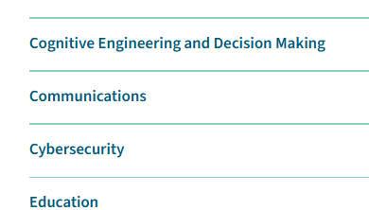
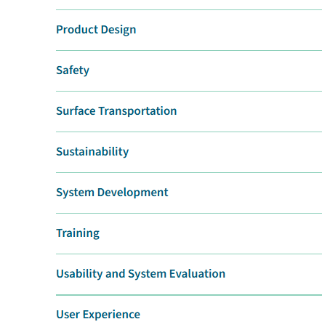
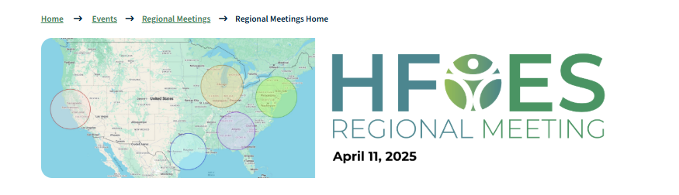
ASPIRE – International Annual Meeting
Technical Groups
~1,000 presentations, posters, and demonstrations
Networking
Mentoring
Job Center
Most current science, application, and practice of HFE
Regional Meetings

Slide 8


Slide 9
Thanks for having me!
Happy to connect
president@hfes.org
S. Camille Peres

